Slide 1




GOLDEN HEARTS COMMUNITY OUTREACH Volunteering at old age homes
SRM INSTITUTE OF SCIENCE AND TECHNOLOGY
SCHOOL OF COMPUTING
DEPARTMENT OF COMPUTING TECHNOLOGIES
Name: ANIRUDHAN M
Reg no: RA2211003010824
Name : MITHUN S
Reg no : RA2211003010835
Name : VIGNESH A
Reg no : RA2211003010839
Name : MADAVAN G
Reg no : RA2211003010841
Faculty Advisor Name: Mrs. Kanmani S.P,
Designation: Assistant Professor Department: Computing Technologies

Slide 2



GOLDEN HEARTS COMMUNITY OUTREACH
Introduction of the Organization
Location:
Located at 5, Noombal Rd, Velappanchavadi, Kattupakkam, Chennai, Tamil Nadu 600077,
Akshaya Trust operates from a peaceful and well-equipped ashram. The facility is designed to ensure the comfort and well-being of its residents, featuring clean living spaces, medical facilities, recreational areas, and nutritious meals. Managed by a team of dedicated professionals and volunteers, the trust has earned a strong reputation for its compassionate care programs.

Slide 3

GOLDEN HEARTS COMMUNITY OUTREACH
Overview:
Akshaya Trust is a dedicated non-profit organization established with the noble aim of providing care, support, and companionship to the elderly. It serves as a sanctuary for senior citizens in need of assistance, offering a compassionate and comprehensive approach to enhance their quality of life. The trust addresses the physical, emotional, and social needs of its residents, creating a safe and nurturing environment where they can enjoy their golden years
Mission and Purpose:
The mission of serving at Akshaya Trust is rooted in the belief of giving back to the community by supporting and valuing the elderly. Volunteers provide companionship, care, and emotional support, ensuring seniors are not isolated or overlooked. The purpose is to make a meaningful impact by enhancing their quality of life.

Slide 4
GOLDEN HEARTS COMMUNITY OUTREACH
Service rendered :
Serving at Akshaya Trust is driven by the belief in giving back to the community and supporting the elderly, who are often overlooked. Through companionship, care, and practical assistance such as serving food, providing entertainment, and offering physical support, volunteers contribute to improving the quality of life for the residents.
This holistic service approach brings fulfillment to both the elderly and volunteers, fostering empathy, compassion, and personal growth. Akshaya Trust stands as a model of care and community, where volunteers make a meaningful impact in the lives of the elderly.

Slide 5

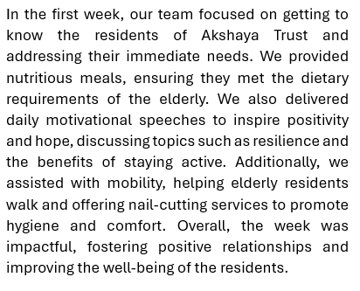
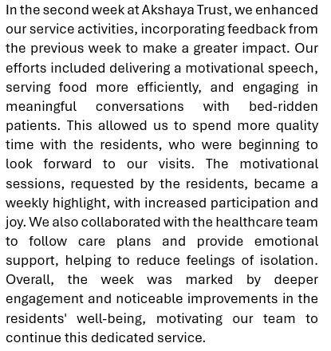
GOLDEN HEARTS COMMUNITY OUTREACH
Events and Activities :
WEEK 1: WEEK 2:

Slide 6
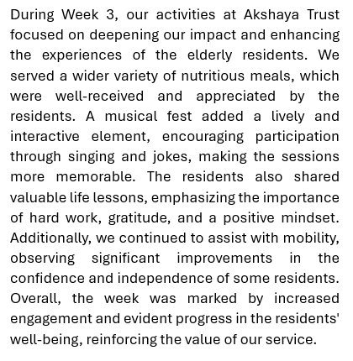
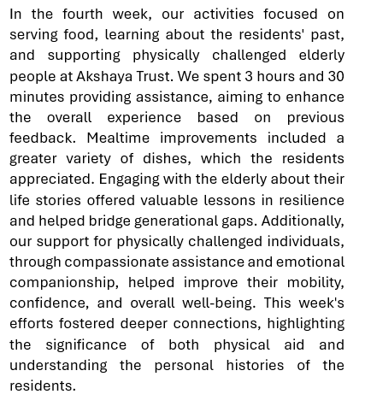
GOLDEN HEARTS COMMUNITY OUTREACH
Events and Activities :
WEEK 3: WEEK 4:

Slide 7

GOLDEN HEARTS COMMUNITY OUTREACH
Events and Activities done individually :
Individual Contributions at Akshaya Trust
M ANIRUDHAN – RA2211003010824
Serving Food: Prepared and served meals, accommodating dietary preferences to create a pleasant dining experience and foster community interaction.
Singing Songs: Led engaging music sessions with simple instruments, promoting joy and entertainment among residents.
Creating Joy: Shared jokes and stories, uplifting spirits and enhancing the overall mood of the residents.
Hygiene Assistance: Organized nail-cutting sessions to maintain personal hygiene, providing comfort and care.
Reflection: These experiences taught me empathy, patience, and the value of human connection. I developed a sense of responsibility and a commitment to serving others, making a positive impact in the lives of the elderly.

Slide 8

GOLDEN HEARTS COMMUNITY OUTREACH
Individual Contributions at Akshaya Trust
MITHUN S – RA2211003010835
Serving Food: Assisted in preparing and serving nutritious meals, brightening residents’ days with kindness.
Life Lessons: Learned invaluable wisdom from residents, deepening my understanding of resilience and gratitude.
Mobility Assistance: Supported residents in walking, enhancing their mobility and fostering personal connections.
Eliciting Nostalgia: Encouraged discussions about cherished memories, creating a warm and uplifting atmosphere.
Reflection: These activities enriched my life, reinforcing my commitment to compassion and community service, while significantly enhancing the residents' well-being.

Slide 9

GOLDEN HEARTS COMMUNITY OUTREACH
Individual Contributions at Akshaya Trust
VIGNESH A – RA2211003010839
Serving Food: Actively involved in preparing and serving nutritious meals, focusing on dietary preferences to create an enjoyable dining experience.
Positive Conversations: Engaged in uplifting discussions, boosting residents’ self-esteem and reinforcing their sense of worth and belonging.
Mobile Device Assistance: Provided support for residents' mobile phones, helping them stay connected with loved ones and enhancing their sense of independence.
Motivational Speeches: Delivered speeches on resilience and positivity, uplifting residents’ spirits and encouraging them.
Reflection: These experiences taught me empathy, effective communication, and the importance of creative engagement. They reinforced my commitment to community service and inspired me to continue contributing to the well-being of others.

Slide 10
GOLDEN HEARTS COMMUNITY OUTREACH
Individual Contributions at Akshaya Trust
MADAVAN G – RA2211003010841
Serving Food: Ensured prompt and attentive meal service, fostering a welcoming atmosphere that encouraged social interaction.
Singing Songs: Organized music sessions, encouraging participation to bring joy and relaxation to residents.
Moral Support: Engaged in meaningful conversations, reinforcing residents’ sense of value within the community through companionship.
Mobility Assistance: Provided physical support for residents’ mobility, fostering independence and building strong personal connections.
Reflection: These experiences deepened my empathy and highlighted the importance of compassionate care. Each interaction reinforced the value of genuine connection, contributing significantly to my personal and professional development.

Slide 11

GOLDEN HEARTS COMMUNITY OUTREACH
Member Testimonials:
M ANIRUDHAN – RA2211003010824
Success Story:
"At Akshaya Trust, every moment spent with the residents was a chance to learn and grow. From serving meals to making them laugh, my experience was filled with joy and meaningful connections." — M Anirudhan
Quote: "Bringing smiles to the faces of the elderly was my greatest achievement.“
For a glimpse into the program’s activities , go to:
https://drive.google.com/drive/folders/11kga53skyIjzb3dD0Ste83ef5Udkpp_K

Slide 12
GOLDEN HEARTS COMMUNITY OUTREACH
MITHUN S – RA2211003010835
Success Story: "Engaging with the elderly residents at Akshaya Trust taught me invaluable life lessons. Their stories of resilience and joy enriched my life and deepened my understanding of compassion." — Mithun S
Quote: "Every conversation with the residents was a treasure trove of wisdom.“
For a glimpse into the program’s activities , go to:
https://drive.google.com/drive/folders/11kga53skyIjzb3dD0Ste83ef5Udkpp_K

Slide 13
GOLDEN HEARTS COMMUNITY OUTREACH
VIGNESH A – RA2211003010839
Success Story: "Working with the elderly residents has been one of the most rewarding experiences of my life. Engaging in meaningful conversations and helping them with their mobile devices not only enhanced their well-being but also taught me valuable life lessons." — Vignesh A
Quote: "Every smile and every story shared made me realize how impactful our presence can be in their lives.“
For a glimpse into the program’s activities , go to:
https://drive.google.com/drive/folders/11kga53skyIjzb3dD0Ste83ef5Udkpp_K

Slide 14

GOLDEN HEARTS COMMUNITY OUTREACH
MADAVAN G – RA2211003010841
Success Story: "Serving food and singing songs brought joy not only to the residents but also to me. It was heartwarming to see their faces light up and to know I contributed to their happiness." — Madavan G
Quote: "The bonds I formed with the residents will always hold a special place in my heart.“
For a glimpse into the program’s activities , go to:
https://drive.google.com/drive/folders/11kga53skyIjzb3dD0Ste83ef5Udkpp_K

Slide 15
GOLDEN HEARTS COMMUNITY OUTREACH
Tangible Learning Outcomes:
Summary of Student's Learning:
Engaging in service activities at Akshaya Trust has been a transformative experience, offering practical lessons beyond academics. Key learnings include:
Enhanced Empathy and Compassion:
Developed a deeper sense of empathy through interactions with elderly residents.
Learned the importance of patience, kindness, and understanding.
Effective Communication Skills:
Improved skills in conveying information clearly and simply.
Gained experience in active listening to ensure residents feel heard and valued.
Teamwork and Collaboration:
Learned the value of coordinated efforts in a team setting.
Appreciated diverse skills and perspectives for effective service delivery.

Slide 16
GOLDEN HEARTS COMMUNITY OUTREACH
Tangible Learning Outcomes:
Problem-Solving and Adaptability:
Enhanced ability to handle challenges like meal preferences and mobility issues.
Developed skills in thinking on the feet and adapting to changing situations.
2. Organizational and Time Management Skills:
Practiced balancing multiple tasks effectively.
Learned to prioritize and manage time for smooth activity flow.
3. Understanding of Geriatric Care:
Gained foundational knowledge of elderly care needs.
Recognized the importance of maintaining the dignity and independence of the elderly.

Slide 17

GOLDEN HEARTS COMMUNITY OUTREACH
Tangible Learning Outcomes:
Benefits to the End Users:
1.Improved Nutrition and Health:
Regular, balanced meals tailored to dietary needs.
Resulted in better health, increased energy, and overall well-being.
2.Enhanced Emotional Well-Being:
Singing sessions and motivational talks lifted spirits.
Helped reduce loneliness and depression, providing hope and positivity.
3.Increased Social Interaction:
Activities like singing and group meals fostered social bonds.
Promoted a sense of community, reducing isolation.

Slide 18
GOLDEN HEARTS COMMUNITY OUTREACH
Tangible Learning Outcomes:
4. Improved Mobility and Independence:
Physical assistance led to better mobility and confidence.
Residents gained more autonomy and self-reliance.
5.Maintained Hygiene and Comfort:
Regular personal care ensured good hygiene and health.
Contributed to dignity and self-respect.
6.Enhanced Quality of Life:
Combined benefits of nutrition, social interaction, emotional support, and care.
Led to greater happiness, satisfaction, and a sense of being valued.

Slide 19

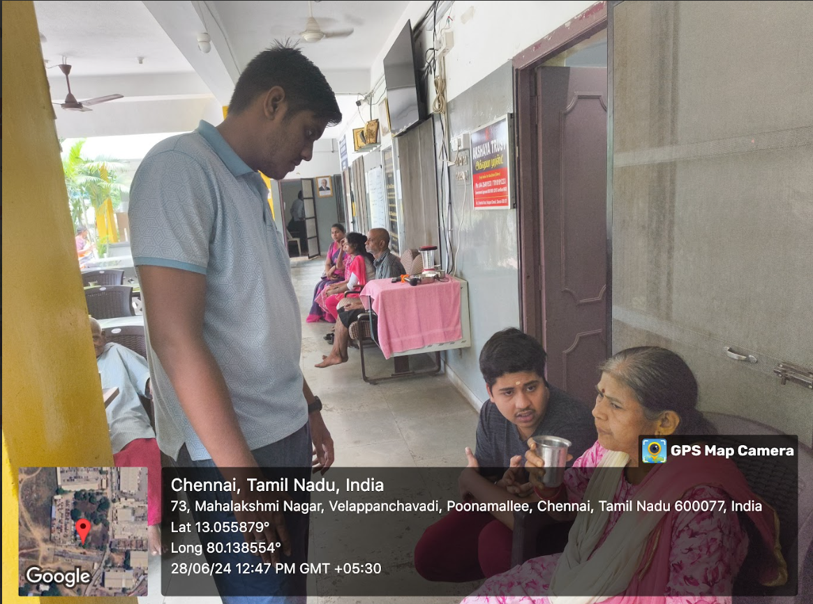
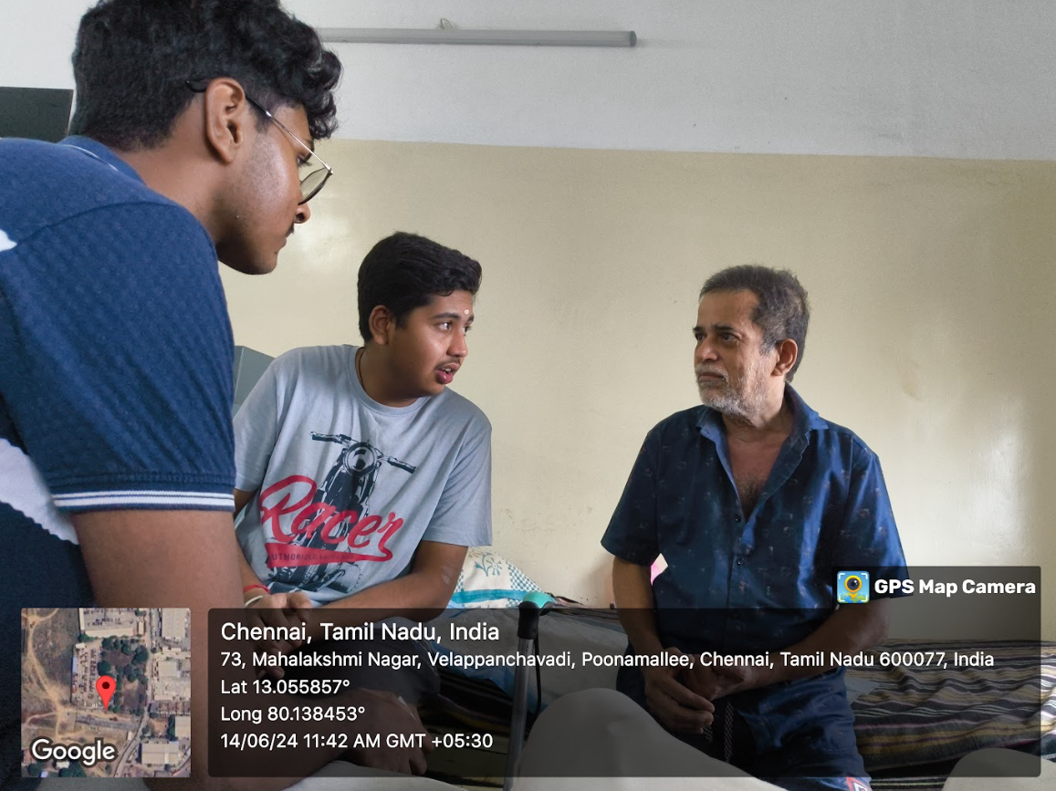
GOLDEN HEARTS COMMUNITY OUTREACH
Photo Proof :

Slide 20
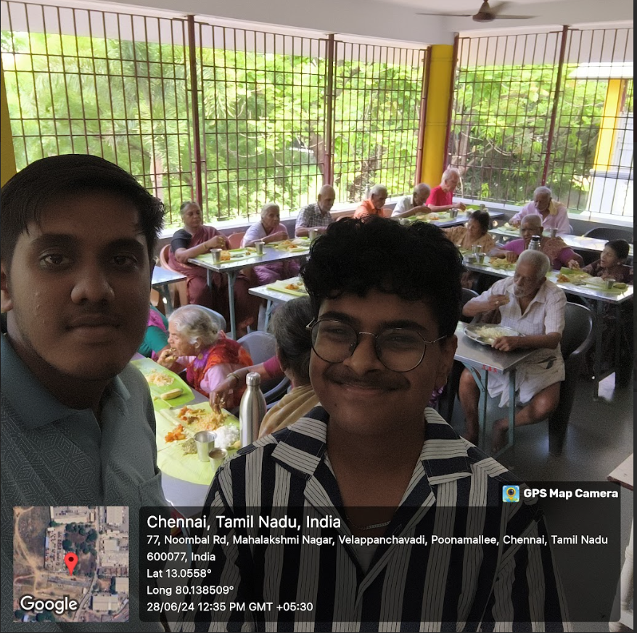
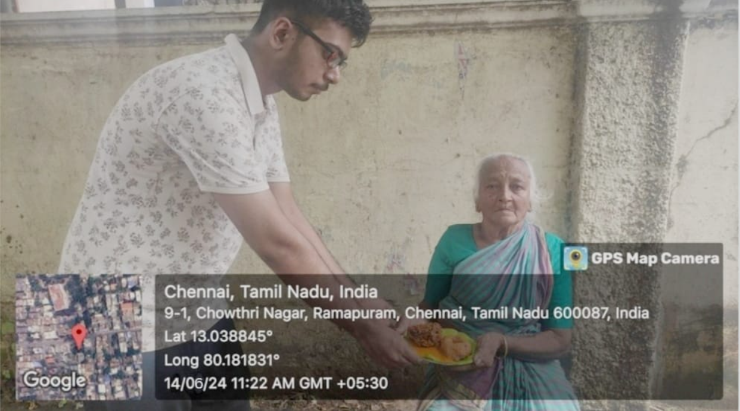

GOLDEN HEARTS COMMUNITY OUTREACH
Photo Proof :

Slide 21

Conclusion and Takeaways:
The Community Connect initiative at Akshaya Trust has been a deeply rewarding experience, benefiting both the elderly residents and the volunteers.
By providing essential services such as nutritious meals, entertainment, motivational talks, and personal hygiene support, the initiative not only enhanced the residents' quality of life but also fostered a sense of joy and community.
Our choice of Akshaya Trust was guided by a commitment to addressing the often-overlooked needs of the elderly, aligning with the Trust's dedication to providing a nurturing environment. This collaboration has resulted in holistic care that integrates the physical, emotional, and social well-being of the elderly.
For the volunteers, the initiative offered significant learning experiences, developing empathy, responsibility, and communication skills.
The bonds formed and positive feedback received have reinforced the value of small acts of kindness. In conclusion, Community Connect has achieved its objectives, delivering essential care and fostering growth among all participants, while highlighting the profound impact of compassion and proactive community service in enriching the lives of the elderly

